Slide 1

Adam optimizer
Najmieh sadat safarabadi winter 2023

Slide 2
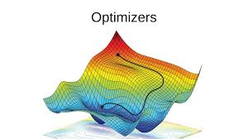
What is an optimizer?
A deep learning model consists of activation function, input, output, hidden layers, loss function, etc.
Any deep learning model tries to generalize the data using an algorithm and tries to make predictions on the unseen data.
We need an algorithm that maps the examples of inputs to that of the outputs and an optimization algorithm.
An optimization algorithm finds the value of the parameters(weights) that minimize the error when mapping inputs to outputs.

Slide 3
Why does the choice of optimizer matters?
Optimization algorithms are typically defined by their update rule, which is controlled by hyperparameters that determine its behaviours (e.g. the learning rate)
Optimizers are mathematical functions which are dependent on model’s learnable parameters i.e Weights & Biases. Optimizers help to know how to change weights and learning rate of neural network to reduce the losses.
The choice of optimization algorithm for your deep learning model can mean the difference between good results in minutes, hours, and days

Slide 4
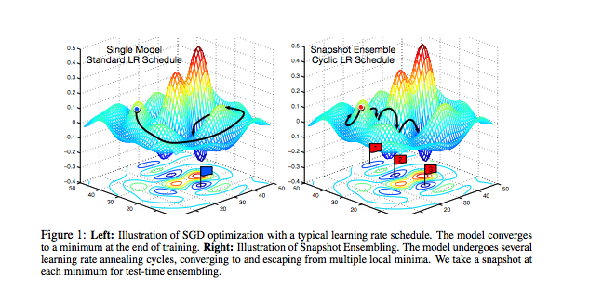
What is an optimizer?
These optimization algorithms or optimizers widely affect the accuracy of the deep learning model.
They as well as affect the speed training of the model. But first of all the question arises what an optimizer really is?

Slide 5
What really is an optimizer?
the concept of loss, which tells us how poorly the model is performing at that current instant. Now we need to use this loss to train our network such that it performs better.
Essentially what we need to do is to take the loss and try to minimize it, because a lower loss means our model is going to perform better. The process of minimizing (or maximizing) any mathematical expression is called optimization and we need now see how we can use these optimization methods for neural networks.
Typical issues: Stochastic Gradient Descent and how to address problems like getting stuck in a local minima or a saddle point.
Other problem: pathological curvature can slow down training to an extent that the machine learning practitioner might think that search has converged to a sub-optimal minima

Slide 6
Pathological curvature can slow down training to an extent that the machine learning practitioner might think that search has converged to a sub-optimal minima. Let us understand in depth what pathological curvature is.
You see, we start off randomly before getting into the ravine-like region marked by blue colour.
The colours actually represent how high the value the loss function is at a particular point, with reds representing highest values and blues representing the lowest values.
We want to get down to the minima, but for that we have move through the ravine. This region is what is called pathological curvature. To understand why it's called pathological , let us delve deeper. This is how pathological curvature, zoomed up, looks like

Slide 7
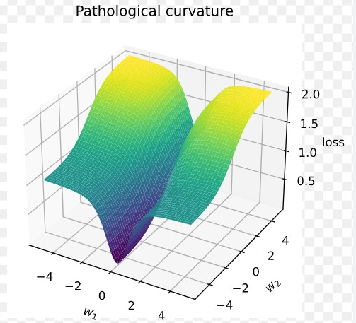
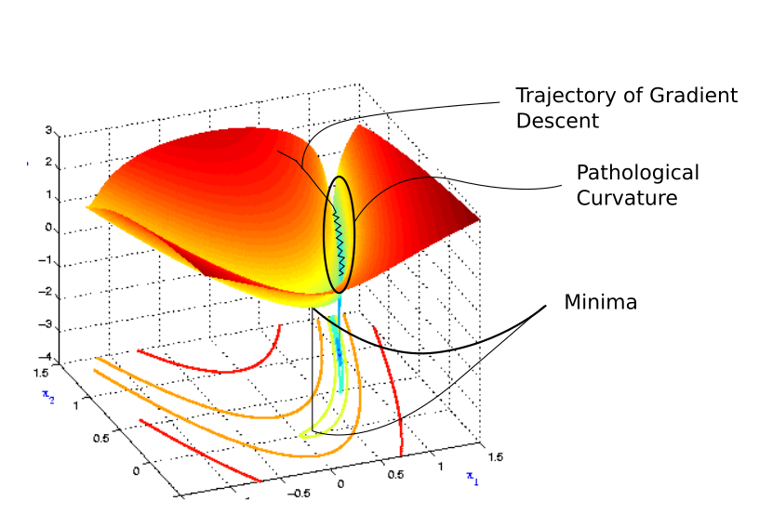

Slide 8
Gradient descent is bouncing along the ridges of the ravine, and moving a lot slower towards the minima. This is because the surface at the ridge curves much more steeply in the direction of w1.
if the only directions of significant decrease in f are ones of low curvature, the optimization may become too slow to be practical and even appear to halt altogether, creating the false impression of a local minimum.

Slide 9
Pathological curvature
It makes sense to slow down when were are nearing a minima, and we want to converge into it. But consider the point where gradient descent enters the region of pathological curvature, and the sheer distance to go until the minima.
If we use a slower learning rate, it might take so too much time to get to the minima. In fact, learning rates small enough to prevent bouncing around the ridges might lead the practitioner to believe that the loss isn't improving at all, and abandon training all together.
And if the only directions of significant decrease in f are ones of low curvature
Probably we want something that can get us slowly into the flat region at the bottom of pathological curvature first, and then accelerate in the direction of minima

Slide 10
Optimizer variant
Gradient Descent
Stochastic Gradient Descent (SGD)
Mini Batch Stochastic Gradient Descent (MB-SGD)
SGD with momentum
Nesterov Accelerated Gradient (NAG)
Adaptive Gradient (AdaGrad)
AdaDelta
RMSprop
Adam

Slide 11
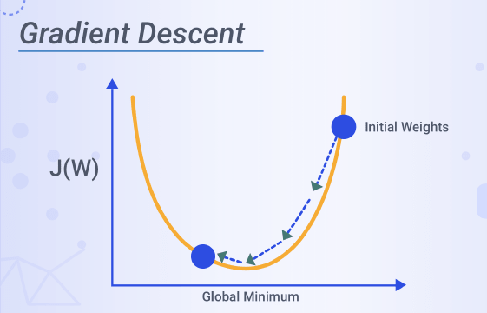
A quick overview of Gradient Descent and the stochastic version of it
Gradient descent is. It's based on a convex function and tweaks its parameters iteratively to minimize a given function to its local minimum.
Gradient Descent is an optimization algorithm for finding a local minimum of a differentiable function.
Gradient descent is simply used to find the values of a function's parameters (coefficients) that minimize a cost function as far as possible.
SGD algorithm is an extension of the Gradient Descent and it overcomes some of the disadvantages of the GD algorithm.
Gradient Descent has a disadvantage that it requires a lot of memory to load the entire dataset of n-points at a time to compute the derivative of the loss function.
In the SGD algorithm derivative is computed taking one point at a time.

Slide 12
SGD performs a parameter update for each training example x(i) and label y(i):
where {x(i) ,y(i)} are the training examples:
θ = θ − α⋅∂(J(θ;x(i),y(i)))/∂θ
To make the training even faster we take a Gradient Descent step for each training example.
On the left, we have Stochastic Gradient Descent (where m=1 per step) we take a Gradient Descent step for each example and on the right is Gradient Descent (1 step per entire training set).

Slide 13
3 issues noted
SGD seems to be quite noisy, at the same time it is much faster but may not converge to a minimum.
Advantage and disadvantages:
It is observed that in SGD the updates take more number iterations compared to gradient descent to reach minima.
On the other hand, the Gradient Descent takes fewer steps to reach minima but the SGD algorithm is noisier and takes more iterations.
Typically, to get the best out of both worlds we use Mini-batch gradient descent (MGD) which looks at a smaller number of training set examples at once to help (usually power of 2 - 2^6 etc.).
Mini-batch Gradient Descent is relatively more stable than Stochastic Gradient Descent (SGD) but does have oscillations as gradient steps are being taken in the direction of a sample of the training set and not the entire set as in BGD.

Slide 14
Advantage:
Memory requirement is less compared to the GD algorithm as the derivative is computed taking only 1 point at once.
Disadvantages:
The time required to complete 1 epoch is large compared to the GD algorithm.
Takes a long time to converge.
May stuck at local minima.

Slide 15
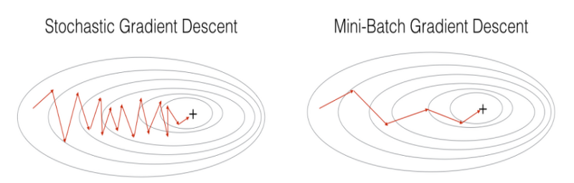
Mini Batch Stochastic Gradient Descent (MB-SGD)
MB-SGD algorithm is an extension of the SGD algorithm and it overcomes the problem of large time complexity in the case of the SGD algorithm.
MB-SGD algorithm takes a batch of points or subset of points from the dataset to compute derivate.
It is observed that the derivative of the loss function for MB-SGD is almost the same as a derivate of the loss function for GD after some number of iterations. But the number of iterations to achieve minima is large for MB-SGD compared to GD and the cost of computation is also large.

Slide 16
Update of weight for the a batch of points
The update of weight is dependent on the derivate of loss for a batch of points.
The updates in the case of MB-SGD are much noisy because the derivative is not always towards minima. MB-SGD divides the dataset into various batches and after every batch, the parameters are updated.

Slide 17

Mini Batch Stochastic Gradient Descent (MB-SGD)
Advantages:
Less time complexity to converge compared to
standard SGD algorithm.
Disadvantages:
The update of MB-SGD is much noisy compared to the update of the GD algorithm.
Take a longer time to converge than the GD algorithm.
May get stuck at local minima.

Slide 18
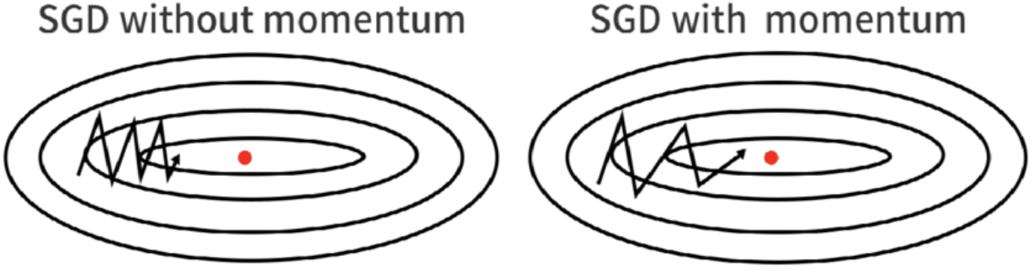
SGD with momentum
A major disadvantage of the MB-SGD algorithm is that updates of weight are very noisy. SGD with momentum overcomes this disadvantage by denoising the gradients.
Updates of weight are dependent on noisy derivative and if we somehow denoise the derivatives then converging time will decrease.

Slide 19
The idea is to denoise derivative using exponential weighting average that is to give more weightage to recent updates compared to the previous update.
It accelerates the convergence towards the relevant direction and reduces the fluctuation to the irrelevant direction.
One more hyperparameter is used in this method known as momentum symbolized by ‘γ’.
Now, the weights are updated by θ = θ − V(t). V(t) = γ.V(t−1) + α.∂(J(θ))/∂θ
The momentum term γ is usually set to 0.9 or a similar value.

Slide 20
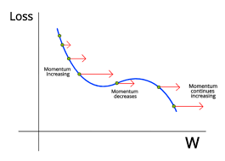
Momentum at time ‘t’ is computed using all previous updates giving more weightage to recent updates compared to the previous update. This leads to speed up the convergence.
Essentially, when using momentum, we push a ball down a hill.
The ball accumulates momentum as it rolls downhill, becoming faster and faster on the way (until it reaches its terminal velocity if there is air resistance, i.e. γ<1).
The same thing happens to our parameter updates: The momentum term increases for dimensions whose gradients point in the same directions and reduces updates for dimensions whose gradients change directions. As a result, we gain faster convergence and reduced oscillation.

Slide 21
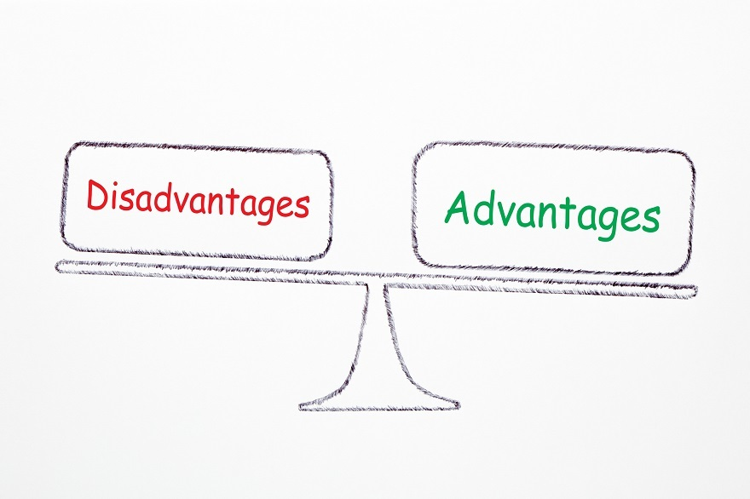
Advantages:
Has all advantages of the SGD algorithm.
Converges faster than the GD algorithm.
Disadvantages:
We need to compute one more variable for each update.

Slide 22
Adaptive Gradient Descent(AdaGrad)
For all the previously discussed algorithms the learning rate remains constant. So the key idea of AdaGrad is to have an adaptive learning rate for each of the weights.
It performs smaller updates for parameters associated with frequently occurring features, and larger updates for parameters associated with infrequently occurring features.
For brevity, we use gt to denote the gradient at time step t. gt,i is then the partial derivative of the objective function w.r.t. to the parameter θi at time step t, η is the learning rate and ∇θ is the partial derivative of loss function J(θi)

Slide 23
In its update rule, Adagrad modifies the general learning rate η at each time step t for every parameter θi based on the past gradients for θi:
where Gt is the sum of the squares of the past gradients w.r.t to all parameters θ.
The benefit of AdaGrad is that it eliminates the need to manually tune the learning rate; most leave it at a default value of 0.01.
Its main weakness is the accumulation of the squared gradients(Gt) in the denominator. Since every added term is positive, the accumulated sum keeps growing during training, causing the learning rate to shrink and becoming infinitesimally small and further resulting in a vanishing gradient problem.

Slide 24
Advantage:
No need to update the learning rate manually as it changes adaptively with iterations.
Disadvantage:
As the number of iteration becomes very large learning rate decreases to a very small number which leads to slow convergence.

Slide 25
Adam
Adam optimizer is the extended version of stochastic gradient descent which could be implemented in various deep learning applications such as computer vision and natural language processing in the future years.
Adam was first introduced in 2014. It was first presented at a famous conference for deep learning researchers called ICLR 2015. It is an optimization algorithm that can be an alternative for the stochastic gradient descent process. The name is derived from adaptive moment estimation.
The optimizer is called Adam because uses estimations of the first and second moments of the gradient to adapt the learning rate for each weight of the neural network. The name of the optimizer is Adam; it is not an acronym

Slide 26
Adam optimizer
Adam is proposed as the most efficient stochastic optimization which only requires first-order gradients where memory requirement is too little.
Adam was introduced which is better in terms of generalizing performance.
Also in Adam, the hyperparameters have intuitive interpretations and hence required less tuning.
Adam performs well. But in some cases, researchers have observed Adam doesn't converge to the optimal solution, SGD optimizer does instead.

Slide 27
In a diverse set of deep learning tasks sometimes Adam optimizers have low generalizing performance.
switching to SGD in some cases show better generalizing performance than Adam alone
In Adam instead of adapting learning rates based on the average first moment as in RMSP, Adam makes use of the average of the second moments of the gradients. This algorithm calculates the exponential moving average of gradients and square gradients.
And the parameters of β1 and β2 are used to control the decay rates of these moving averages. Adam is a combination of two gradient descent methods, Momentum, and RMSP which are explained below.

Slide 28
Momentum
This is an optimization algorithm that takes into consideration the 'exponentially weighted average' and accelerates the gradient descent. It is an extension of the gradient descent optimization algorithm.^{[3]}
The Momentum algorithm is solved in two parts. The first is to calculate the position change and the second is to update the old position.

Slide 29
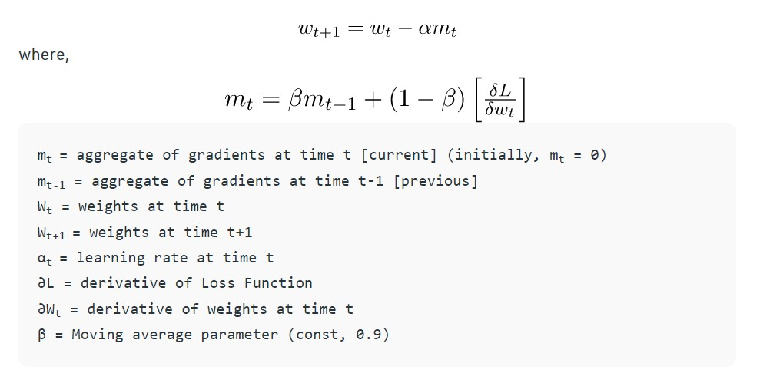
momentum

Slide 30
how Does Adam Work?
Adam is different to classical stochastic gradient descent.
Stochastic gradient descent maintains a single learning rate (termed alpha) for all weight updates and the learning rate does not change during training.
the method computes individual adaptive learning rates for different parameters from estimates of first and second moments of the gradients.

Slide 31
e authors describe Adam as combining the advantages of two other extensions of stochastic gradient descent. Specifically:
Adaptive Gradient Algorithm (AdaGrad) that maintains a per-parameter learning rate that improves performance on problems with sparse gradients (e.g. natural language and computer vision problems).
Root Mean Square Propagation (RMSProp) that also maintains per-parameter learning rates that are adapted based on the average of recent magnitudes of the gradients for the weight (e.g. how quickly it is changing). This means the algorithm does well on online and non-stationary problems (e.g. noisy)
RMSProp is designed to accelerate the optimization process, e.g. decrease the number of function evaluations required to reach the optima, or to improve the capability of the optimization algorithm, e.g. result in a better final result.

Slide 32
Adam realizes the benefits of both AdaGrad and RMSProp.
Instead of adapting the parameter learning rates based on the average first moment (the mean) as in RMSProp, Adam also makes use of the average of the second moments of the gradients (the uncentered variance).
Specifically, the algorithm calculates an exponential moving average of the gradient and the squared gradient, and the parameters beta1 and beta2 control the decay rates of these moving averages.
The initial value of the moving averages and beta1 and beta2 values close to 1.0 (recommended) result in a bias of moment estimates towards zero. This bias is overcome by first calculating the biased estimates before then calculating bias-corrected estimates.

Slide 33
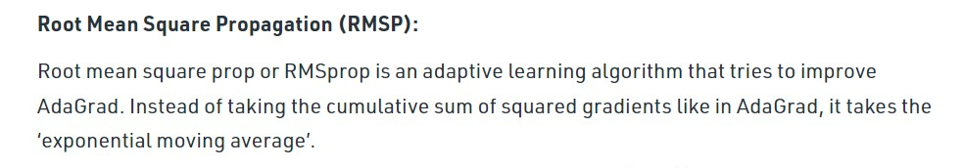
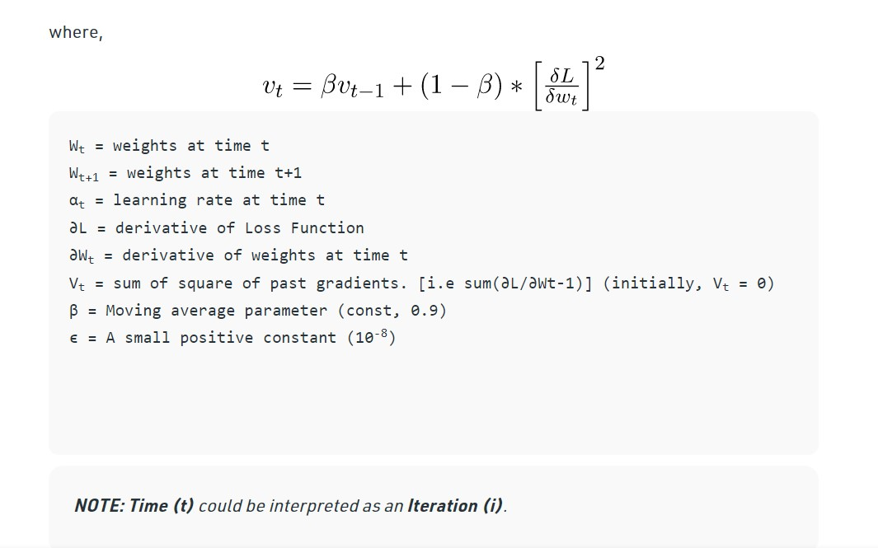

Slide 34
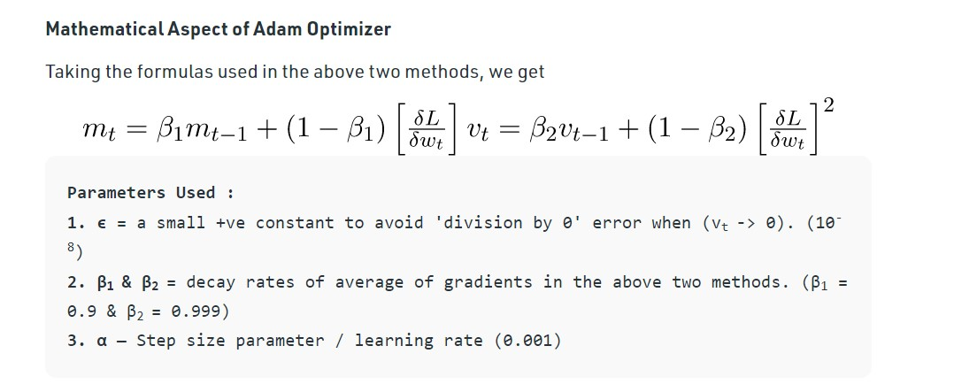

Slide 35
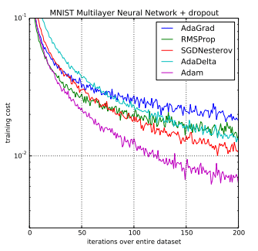
In the original paper, Adam was demonstrated empirically to show that convergence meets the expectations of the theoretical analysis.
Adam was applied to the logistic regression algorithm on the MNIST digit recognition and IMDB sentiment analysis datasets, a Multilayer Perceptron algorithm on the MNIST dataset and Convolutional Neural Networks on the CIFAR-10 image recognition dataset. They conclude:
Using large models and datasets, we demonstrate Adam can efficiently solve practical deep learning problems.

Slide 36
Adam Configuration Parameters
alpha. Also referred to as the learning rate or step size. The proportion that weights are updated (e.g. 0.001). Larger values (e.g. 0.3) results in faster initial learning before the rate is updated. Smaller values (e.g. 1.0E-5) slow learning right down during training
beta1. The exponential decay rate for the first moment estimates (e.g. 0.9).
beta2. The exponential decay rate for the second-moment estimates (e.g. 0.999). This value should be set close to 1.0 on problems with a sparse gradient (e.g. NLP and computer vision problems).
epsilon. Is a very small number to prevent any division by zero in the implementation (e.g. 10E-8)

Slide 37
Straightforward to implement.
Computationally efficient.
Little memory requirements.
Invariant to diagonal rescale of the gradients.
Well suited for problems that are large in terms of data and/or parameters.
Appropriate for non-stationary objectives.
Appropriate for problems with very noisy/or sparse gradients.
Hyper-parameters have intuitive interpretation and typically require little tuning.

Slide 38
References
https://arxiv.org/pdf/1910.05446.pdf
https://www.kdnuggets.com/
https://blog.paperspace.com/intro-to-optimization-momentum-rmsprop-adam/
https://optimization.cbe.cornell.edu/

Slide 39
THAN YOU FOR YOUR ATTENTION

